Slide 1
PROG6212 POE
Kaeden Samsunder

Slide 2
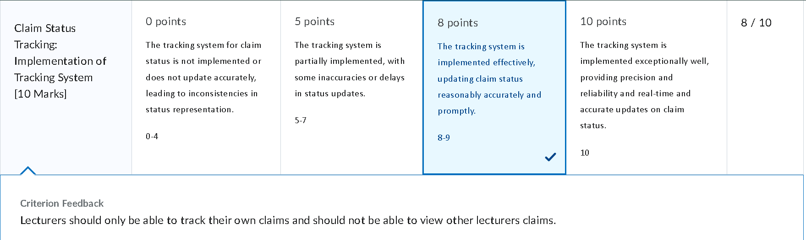
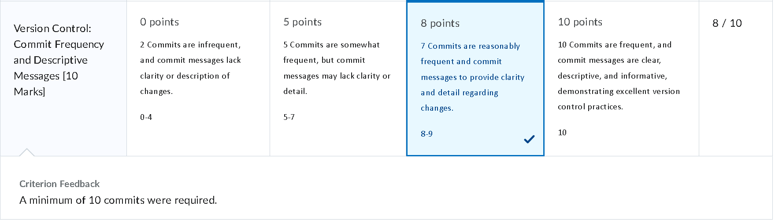
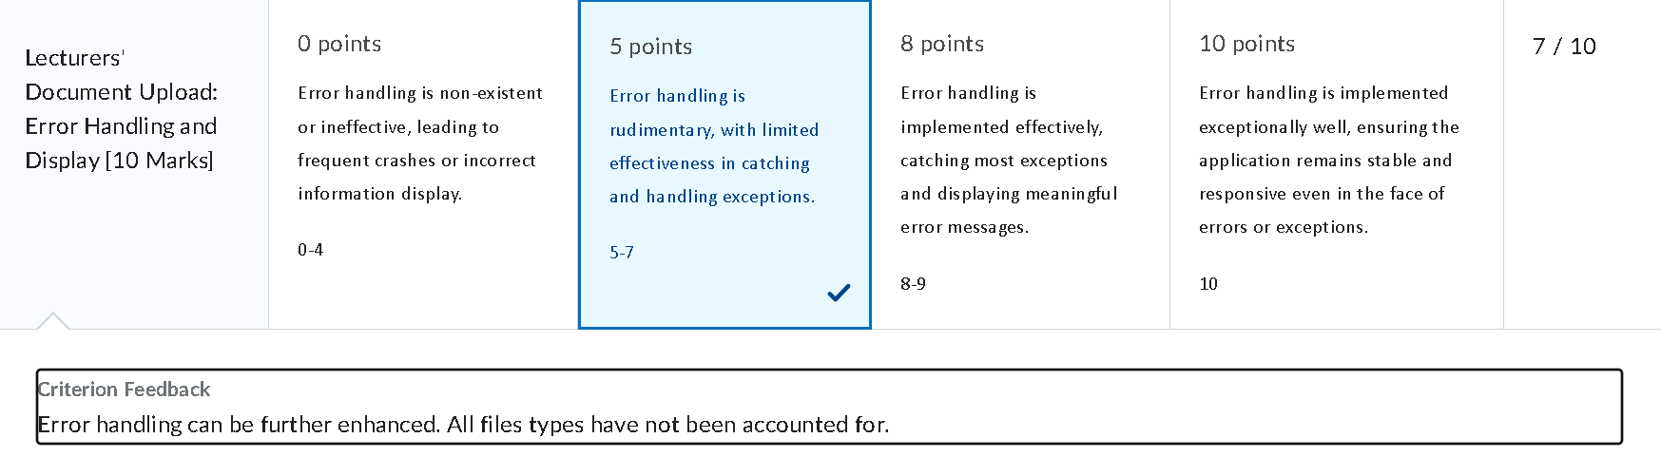
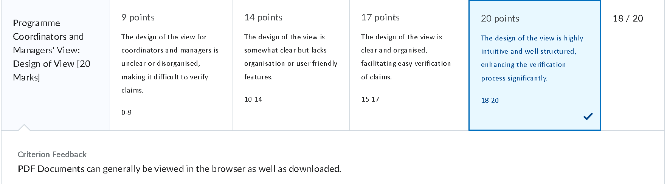
Feedback from Lecturer
PDF Documents can generally be viewed in the browser as well as downloaded.
Error handling can be further enhanced. All files types have not been accounted for.
Lecturers should only be able to track their own claims and should not be able to view other lecturers claims.
A minimum of 10 commits were required.

Slide 3

Updates from Part 2 to Part 3
Database & Storage
Users, claims, and document metadata stored in database
Uploaded documents stored in program
Metadata includes filename and decryption key
Login & Sessions
HR, PC, AM seeded; lecturers login with session management
Role-based access ensures users see only allowed views
HR Super User Features
Create/edit lecturer profiles with hourly rates
Generate invoices/reports for approved claims
Lecturer View
Submit claims with auto-calculated totals
Only own claims visible; validation prevents excess hours
Upload encrypted supporting documents
Admin & General Improvements
Admins (PC & AM) approve and verify claims
PDFs viewable in-browser or downloadable
File validation enhanced
JSON replaced with EF Core database logic
Minimum 10 commits documented
Enhanced error handling and validation

Slide 4
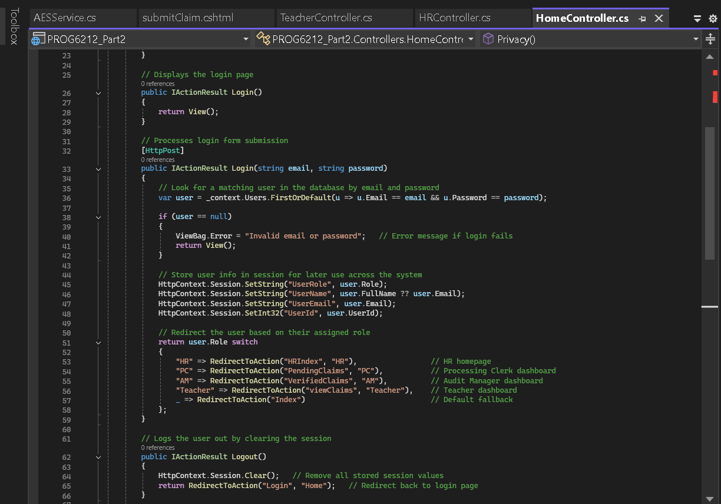
Sessions and Login Feature
Users (HR, PC, AM, Lecturers) log in with email and password stored in the database.
Controller validates credentials against the `Users` table in the database.
On successful login, user role and email are stored in session variables.
Session variables control access and visibility of pages and features.
Lecturers can only view and submit their own claims; HR can access all claims.
Protects sensitive data and enforces role-based access control.
Session management ensures users stay logged in while navigating the application.
Uses ASP.NET Core session state with `HttpContext.Session` for storing user info.

Slide 5
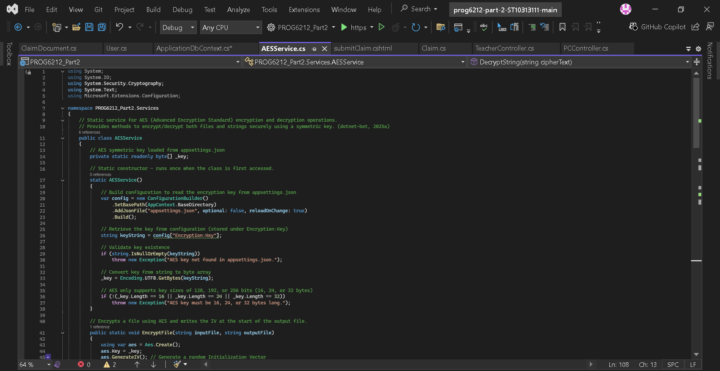
Key Feature: AES Encryption Service
AESService handles encryption/decryption of strings and files
Key loaded from appsettings.json for secure storage
Encrypts uploaded claim documents before saving to DB
Decryption happens only when user accesses the document

Slide 6
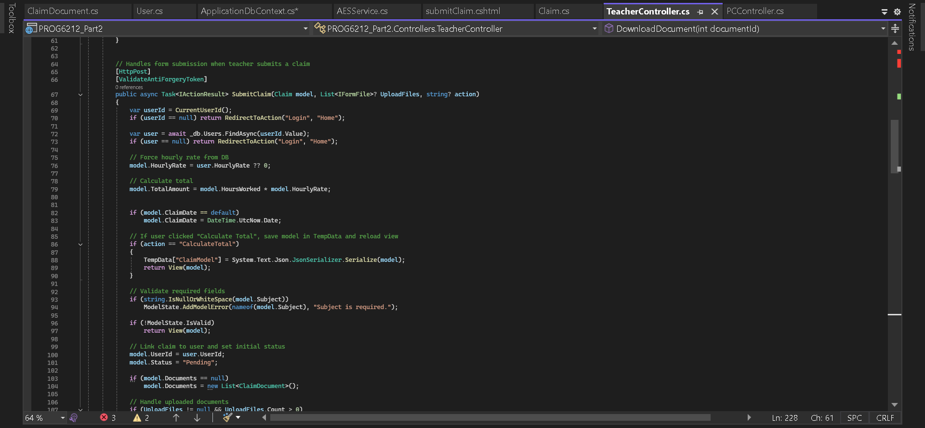
Key Feature: Claims Form
Razor View uses ASP.NET Core Tag Helpers for binding
Real-time calculation of total amount based on hours worked
Upload multiple files with type restrictions (PDF, Word, Excel, Images)
Lecturer can only submit/view their own claims

Slide 7
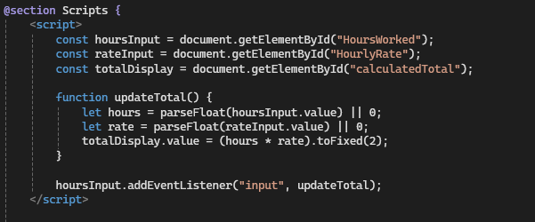
JavaScript: Calculate Total
Automatically calculates Total Amount when lecturer enters hours worked.
HoursWorked is editable; HourlyRate is readonly and loaded from the controller via the model.
JavaScript selects inputs using document.getElementById and listens for input events.
On each input change, HoursWorked × HourlyRate updates calculatedTotal in real-time.
Ensures displayed total matches the value saved to the database by the controller.
Improves user experience by providing instant feedback and preventing manual errors.
Lightweight: no page reload needed, fully integrated with Razor view and controller data.

Slide 8
Generate Invoices Feature
Allows HR to generate invoices for submitted lecturer claims.
Pulls claim data from the database, including lecturer name, hours worked, rate, and total amount.
Automatically formats data into an invoice layout (PDF/print-friendly format).
Ensures only HR users can access this feature for security and privacy.
Uses Razor view to display invoice details; controller handles data retrieval and calculation.
Supports downloading or printing the invoice directly from the browser.
Enhances administrative efficiency by reducing manual calculations and paperwork.

Slide 9
Summary
This updated program improves security, usability, and feedback compliance
Key features include encryption, restricted access, and live calculations
All feedback from lecturer successfully addressed

